Slide 1
Detecting Stepping-Stones under the Influence of Packet Chaffing and Jittering
Intrusion Detection Module
Stephen Huang
Department of Computer Science
University of Houston

Slide 2


Contents
Introduction of Evasion Techniques
Detect Attacks with Chaffing
Detect Attacks with Jittering

Slide 3
1. Introduction
Hackers have stolen valuable data files from various servers (medical, financial, defense, etc.).
To do that, they normally use stepping-stones to establish a connection chain.
Correlation based algorithm can detect stepping-stone connections.
Hackers have developed evasion techniques to conquer stepping-stone detection algorithms.

Slide 4



Stepping-Stone Detection
Stepping-Stone

Slide 5
Stepping-Stone Detection
Finding correlation between gaps of incoming packet stream and outgoing packet stream.

Slide 6
Intruder’s Evasion Techniques
Attackers have developed new evasion techniques.
Chaffing: adding additional packets to the stream that are removed later.
Jittering: delaying selected packets will change the characteristics of time intervals of a network stream.
Chaffing has been studied more than jittering.
Hackers can utilize man-in-the-middle tools, such as Mallory, MITM Proxy, to add chaff packets or jitter the network traffic.

Slide 7
Chaffing and Jittering
Chaffed
Jittered

Slide 8
Contents
Introduction of Evasion Techniques
Detect Attacks with Chaffing
Detect Attacks with Jittering

Slide 9
Stepping Stone Problem
Assumptions:
Traffic monitoring done at servers
Interactive stepping-stone streams
Most papers solves the problem based on traffic timing, for purposes of correlating traffic across stepping stones through the network.
Observe a pair of adjacent or non-adjacent streams at monitor , and find out if they belong to the same connection chain.
Also consider
Evasion techniques by intruders such as Chaffing (Extra packets)
Clock Skew

Slide 10

Problem Statement
Compare
Detection Algorithm alarms:
Attack: if two flows are timing correlated.
Normal: otherwise.

Slide 11
Outline
Introduction
Using Existing DTW Methods for Detection
Our New Approaches
Evaluation and Comparison
Summary

Slide 12
Time Warping Based Approaches:
Measures “maximum similarity” between two sequences which may vary in time or speed.
Allows to find an optimal match between two given sequences even if the sequences are "warped" non-linearly in the time axis
i
i
i
i
i+2
time
time
Any distance (Euclidean, Manhattan, …) which aligns the i-th point on one time series with the i-th point on the other may produce a poor similarity score.
A non-linear (elastic) alignment produces a more intuitive similarity measure, allowing similar shapes to match even if they are out of phase in the time axis.

Slide 13
Previous Method I: Dynamic Time Warping (DTW)
Idea: locally recovers the “warped” time axis in order to minimize the local cumulative difference between the aligned points in two time series, and the possible alignments considered included all local compressions and shifts.
Example:
R = {0, 1, 1, 2, 2, 3, 1, 0}
T = {0, 1, 2, 3, 2, 1, 0, 1, 2}
Notes:
DTW uses the local distance d(i_{p,} o_{q}) plus the minimum of three given values DTW(p,q-1), DTW(p-1,q), DTW(p-1,q-1) to calculate DTW(p,q) repeatedly where p = 1, …, n and q = 1, …, m.
Standard dynamic time warping has the time complexity: O(nm), since all the possibilities need to be considered to ensure the optimal answer found. There are other techniques which speed up DTW.

Slide 14
Previous Method I: Dynamic Time Warping (DTW)
Warping Function:
Time Series T
(Target)
1
q
m
To find the best alignment between R and T one needs to find the path through the grid
DTW(p,q) = (r_{p} , t_{q} )
which minimizes the total distance between them.
DTW demanded that every point on both time series had a match (many-to-many mapping)
Time complexity: O(nm).
1
Time Series R
(Reference)
p
DTW(p,q)
n
DIS (n,m)

Slide 15
Previous Method II: Optimal Subsequence with Merge (OSSM)
Assume reference sequence is shorter than or equal to target sequence
This method compares sequence of intervals between two continuous packets
Idea:
Uses the penalty function to skip the outliers on the reference stream, and
Uses the merge operation to remove the outliers on the target stream
“merge” groups the split intervals back to its original condition

Slide 16
If Dummy Packet Occurs…
DTW Algorithm increases the dissimilarity
E.g.
OSSM has better matches
Has the same dissimilarity with or W/O dummy packet
By using merge function
E.g.
merge

Slide 17
Previous Method: Optimal Subsequence with Merge (OSSM)
Warping Function:
Time Series T
(Target)
1
q
m
1-1 mapping
w/o penalty
with penalty
Time Series R
(Reference)
1
 |  |  |  |  |  |  |  | O
OSSM(p,q)
p
OSSM assumes that both reference stream R and target stream T may contain outliers
skips outliers in T with a penalty during the matching process (1-1 mapping)
Time complexity: O(n²m³).
n
Dis(I,O)
May not be at OSSM(n,m)

Slide 18
Problem of previous methods:
DTW
Cannot cope with clock skew
Cannot deal with chaff packet
OSSM
Cope with some a limited amount of chaff
Very high time complexity: OSSM: O(n²m³)

Slide 19
Outline
Introduction
Using Existing DTW Methods for Detection
Our New Approaches
Evaluation and Comparison
Summary

Slide 20
Method I: Dynamic Time Warping with Window (DTWW)
Giving a fixed time window:
Reference Stream R: a subsequence of timestamps with the window from the end.
Target Stream T: a subsequence of timestamps by using a sliding window operation on the upstream
The sliding window has the start point with an increment of 1 second at a time.
Uses the DTW function to calculate the dissimilarity score for every pair of R and T.
The minimum dissimilarity score of all pairs is treated as the final dissimilarity for this connection pair.
Up stream (Target)
t₁ t₂ t₃ t₄ t₅ t₆ t₇ t₈ t₉
Window
Down stream (Reference)
r₁ r₂ r₃ r₄ r₅ r₆ r₇ r₈

Slide 21
An Example of Using DTWW
An example of using DTWW for a normal pair and an attack pair with the clock skew from -10 to +10 sec.
Normal Connection Pair
Stepping-stone Attack Connection Pair
Optimal Dissimilarity Score

Slide 22
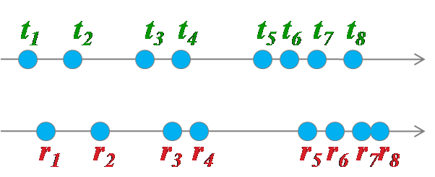
Method II: Dynamic Time Warping with Slope (DTWS)
Compare the slope correlation instead of the timestamp/interval correlation.
Each “slope” (or so called delay) is the timing difference between a packet from reference stream and a packet from target stream
Suppose we are checking at point r₅ and t₄

Slide 23
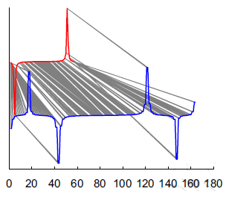
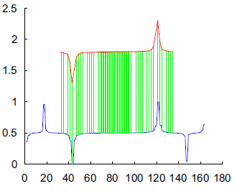
Method III: Optimal Slope Alignment (OSA)
Assumes both reference and target streams may contain outliers.
Reference sequence is shorter than or equal to target sequence
Allows to skip outliers in the target stream
Treats the outliers in the reference stream as the penalties
DTW
OSA

Slide 24
Method III: Optimal Slope Alignment (OSA)
The calculation in a OSA method uses the following function:
For an example: Suppose p=5 and q=4
We can multiply a penalty factor if k=q

Slide 25
Method III: Optimal Slope Alignment (OSA)
Warping Function:
Time Series T
(Target)
1
q
m
1-1 mapping
w/o penalty
Treat as penalty
1
0 0 0 0 0 0 0 0 0 0 0 0 0 0 0 0 0
Time Series R
(Reference)
 |  |  |  |  |  |  |  | O
OSA(p,q)
p
OSA allows the reference stream R to match to only a subsequence of the target stream T
skips outliers in T and treats outliers in R as the penalties during the matching process
many to one mapping
Time Complexity: O(nm²)
n
Dis(R,T)=min{OSA(n,s)|s=1, …m}
May not be at OSA(n,m)

Slide 26
Outline
Introduction
Using Existing DTW Methods for Detection
Our New Approaches
Evaluation and Comparison
Summary

Slide 27
Experiment Design
The collected traffic contains 6 stepping-stone hosts
The number of hop denotes the distance between the hosts.
Of all combinations on each hop, there are 30 streams (attacker i to victim j) which serve as stepping-stone attack connections and the rest of 60 (attacker i to victim j where i ≠ j) streams acting as normal connections.
The threshold to distinguish between normal and attack is estimated via 5-fold cross validation.
Notes:
The collected data contains 30 (3 users times 10 collections) chains with 7 traffic flows (from 0 hop to 6 hop).

Slide 28
Performance w/o Evasion Techniques
The figure shows the worst case
Each attack point represents the maximum dissimilarity score of 30 comparisons
Each normal point represents the minimum dissimilarity score of 60 samples.
DTWW, DTWS, OSA can all find the gap of the dissimilarity score between attack and normal even up to 6 hops.
Dissimilarity Scores for DTWW, DTWS and OSA
(Y-axis uses log scale)

Slide 29
Performance with Evasion Techniques
With Clock Skew Involvement
100% false rate: DTW
23% false rate: DTWW
0% false rate: OSSM, DTWS, OSA
With Chaff involvement
Cannot tolerate chaff: DTW, DTWW, DTWS
Tolerate up to 150% chaff: OSSM (4%FPR, 17%FNR)
Tolerate up to 300% chaff: OSA (8%FPR, 0%FNR)
29

Slide 30
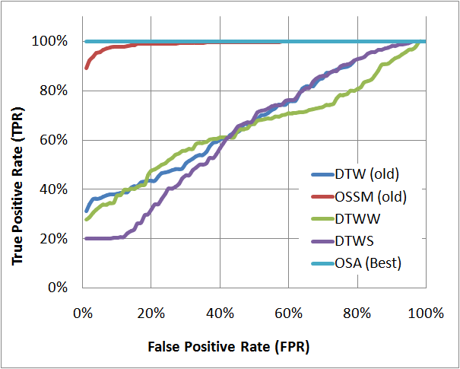
Performance with both Clock Skew and Chaff Involvements
Results are taken from avg. of all the hops (0 to 6 hops) with a 0% to 200% chaff rate (50% CR increments) injected to the target streams.
Better
Methods
ROC curves for DTWS, DTWW, OSA, DTW and OSSM methods

Slide 31
Outline
Introduction
Using Existing DTW Methods for Detection
Our New Approaches
Evaluation and Comparison
Summary

Slide 32
Summary
This paper introduced three new algorithms
DTWW
DTWS
OSA (Best of all)
Our algorithms use modified Time Warping based pattern recognition technique to detect stepping-stones.

Slide 33
Summary
33
Advantage of using our algorithms:
Allows checking adjacent (across a single host) or non-adjacent (across multiple hosts) pair of connections
Works even with time skew issue
DTWS and OSA use Slope correlation
Can tolerates some chaff packets.
OSA has only 8% FPR and 0% FNR with a 300% chaff rates
Low Time complexity
OSA has only O(nm²) compare with OSSM: O(n²m³)
The 6th Int'l Conference on Information Assurance and Security (IAS)
08/23/2010

Slide 34
Contents
Introduction of Evasion Techniques
Detect Attacks with Chaffing
Detect Attacks with Jittering

Slide 35
Jittering Model
The hackers choose his/her jittering strategy. We assume:
Selected packets may be subject to extra delay.
Packet ordering must be maintained.
The amount of jittering is based on a probability distribution.

Slide 36
Hypothesis
If we can detect intentionally jittered traffic, it is a sign of stepping-stone intrusion.
It is necessary to be able to distinguish a normal network traffic from a jittered traffic.
A lightly jittered traffic can be detected by a correlation-based detection algorithm.
We should concentrate on highly jittered traffic.
Extract a feature of the traffic that can provide enough distinction.

Slide 37
2. Network Traffic Modeling
Network traffic flows have been widely studied for more than a decade.
Research on packets inter-arrival time gaps suggests the aggregation of those measurements fit with
General Pareto, and
Lognormal distributions.

Slide 38
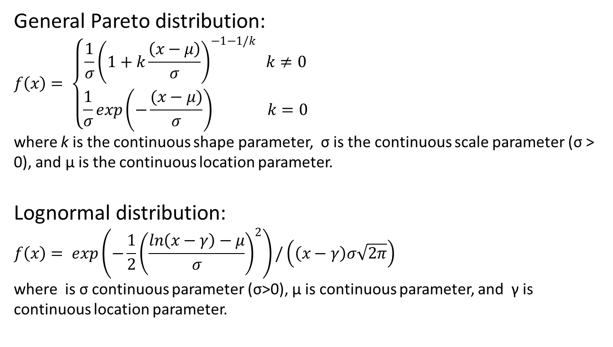
Probability Density Function
General Pareto distribution:
$$f\left(x\right)= \left\{\begin{aligned}\frac{1}{σ}{\left(1+k\frac{\left(x−μ\right)}{σ}\right)}^{−1−1/k} k≠0 \\ \frac{1}{σ}exp\left(−\frac{(x−μ)}{σ}\right) k=0\end{aligned}\right.$$
where k is the continuous shape parameter, σ is the continuous scale parameter (σ > 0), and μ is the continuous location parameter.
Lognormal distribution:
$$f\left(x\right)= exp\left(−\frac{1}{2}{\left(\frac{\ln\left(x−γ\right)−μ}{σ}\right)}^{2}\right)/\left(\left(x−γ\right)σ\sqrt{2π}\right)$$
where is σ continuous parameter (σ>0), μ is continuous parameter, and γ is continuous location parameter.

Slide 39
Estimate Parameters by Maximum Likelihood
Given the traffic model and traffic stream, we can estimate distribution parameters by MLE.
Input:
A set of observed inter-arrival time gaps {x₁, ... , x_{n} }
The probability density function f(x) of a testing distribution model (e. g. General Pareto Distribution).
Output:
The estimated parameters of the testing model.
θ = {θ₁, θ₂, …, θ_{k}} was a vector defined on a k-dimensional parameter space
Notes:
In statistics, MLE is a method of estimating the best fit parameters of a statistical model.
In general, for a fixed set of data and underlying statistical model, the MLE selects values of the model parameters that produce a distribution that gives the observed data the greatest probability (i.e., parameters that maximize the likelihood function).
Given the fixed observing inter-arrival time values {x₁, x₂, … , x_{n}} of a probability density function f(x) of a testing model with k parameters, whereas θ is the function’s unknown variable, and θ={θ₁, θ₂, …, θ_{k}} was a vector defined on a k-dimensional parameter space. The log-likelihood function evaluates the fit of the distribution to the data set, and it is defined as follows:
To solve the inverse problem, the log-likelihood function ln L is defined by reversing the roles of the data vector x_{i} and the parameter vector in The goal is to find the maximum likelihood estimator which was the closest to the true value .
The hat over l indicates that it is akin to some estimator. Indeed, estimates the expected log-likelihood of a single observation in the model.
The method of maximum likelihood estimates θ₀ by finding a value of θ that maximizes . This method of estimation is a maximum likelihood estimator (MLE) of θ₀:
Thus L represents the likelihood of the parameter w given the observed data x
the PDF is a function of the data given a particular set of parameter values, defined on the data scale. On the other hand, the likelihood function is a function of the parameter given a particular set of observed data, defined on the parameter scale.
PDF tells us the probability of a particular data value for a fixed parameter, whereas L tells us the likelihood (‘‘unnormalized probability’’) of a particular parameter value for a fixed data set.

Slide 40
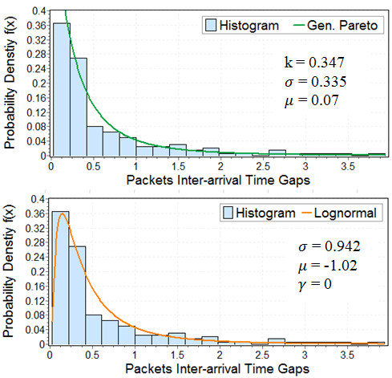
Fitting Data with General Pareto and Lognormal Distributions

Slide 41
Histogram

Slide 42

Fitting Data with General Pareto

Slide 43

Fitting Data with Lognormal

Slide 44
With Jittering

Slide 45

Pareto With Jittering

Slide 46
Strategy
By utilizing parameters of a distribution as a feature to build a classifier, we want to separate jittered traffics from un-jittered ones.

Slide 47
Approach
Selecting a distribution model.
Using parameters of the distribution model as features.
Estimating parameters by MLE.
Given un-jittered traffics and jittered traffics in training phase, using Support Vector Machine to decide the separation hyperplane.
Classifying incoming traffics by the hyperplane .

Slide 48
SVM

Slide 49
Another Case

Slide 50
3. Feature Extraction
Network traffic modeling has already been studied.
Jittering part is controlled by intruders. Choosing which packet to jitter is under Bernoulli distribution. How and how much to jitter are based on jittering distribution and jittering rate.
Different distributions have different parameters. The common parts are mean and standard deviation.
We are going to discuss the impact of those factors.

Slide 51
Impact of Jittering Distribution Models into Detection
Since intruder can use any distribution models to jitter the original connection stream. One cannot pre-assume or control the way of how hackers manipulate the traffic.
After we tried several different distribution models, based on our study, the distribution model used to jitter the traffic does not matter much.

Slide 52
4. Validation
There are several parameters:
Network traffic model,
Jitter delay model,
Jitter rate,
Mean of jitter distribution,
Standard deviation of jitter distribution.
We can pick the network traffic model. Jitter delay distribution does not change the result much.
That leaves us with three parameters to validate.

Slide 53
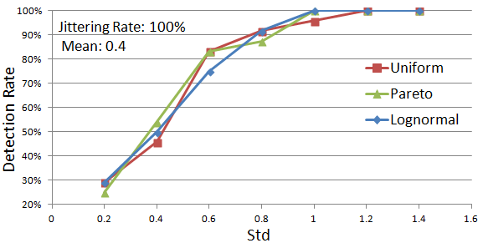
Detect 100% Jittered Traffics with Different Standard deviation

Slide 54
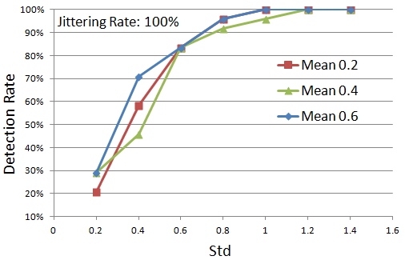
Mean Does Little Impact on Detection Rate
The detection rate is very sensitive to the standard deviation (changes from 30% to 100%) but not sensitive to the mean (0.2, 0.4 and 0.6) of the jittering distribution.

Slide 55
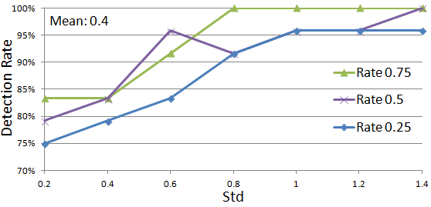
Detect Jittered Streams with Different Jittering Rate
Our method can detect most jittered cases with detection rate mostly at 80% or above.
Detection rate is generally higher for a higher jitter rate even though the detection rates don’t vary too much among the three jitter rates.

Slide 56
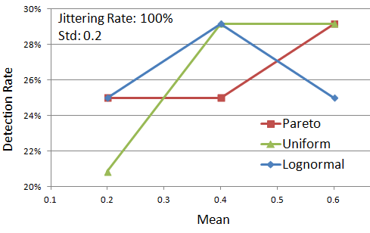
Cases with low detection rate
When packets are closed to 100% being jittered, it is really difficult to detection those jittered traffics when the standard deviation of jitters is small.
However, this case will be detected by the correlation-based detection algorithms, just because the jittered one remains almost the same with the original one.

Slide 57
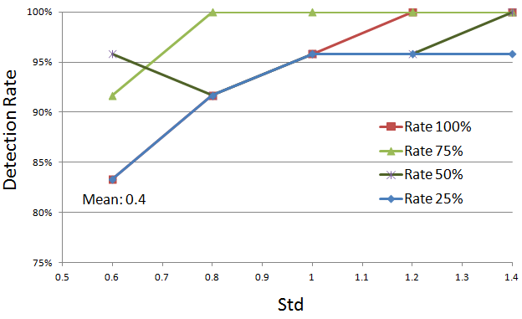
Cases with High Detection Rate
Our method can detect most cases based on the combination of all three factors: mean, standard deviation, and jittering rate.
Experimental results show the detection rate is above 80% for cases with high standard deviation.
Notes:
Mean: 0.4
Dist: Uniform

Slide 58
Result Summary
Detection Rate
False Positive Rate

Slide 59
5. Summary
We have found a set of features of the inter-arrival times that can be used to distinguish a jittered traffic from an un-jittered one when the traffic is highly jittered.
Thus we can distinguish intrusion connections from normal connections by either using a correlation-based algorithm (when jittering is low) or the algorithm presented here (when the jittering is high).

